Slide 1
Chapter 6: Multiple Linear Regression
Data Mining for Business Analytics
Concepts, Techniques and Applications with JMP Pro
Shmueli, Bruce, Stephens & Patel
© Galit Shmueli, Peter Bruce and Mia Stephens 2016

Slide 2
Topics
Explanatory vs. predictive modeling with regression
Example: prices of Toyota Corollas
Fitting a predictive model
Assessing predictive accuracy
Selecting a subset of predictors

Slide 3
Explanatory Modeling
Goal: Explain relationship between predictors (explanatory variables) and target
Familiar use of regression in data analysis
Model Goal: Fit the data well and understand the contribution of explanatory variables to the model
“goodness-of-fit”: R², residual analysis, p-values

Slide 4
Predictive Modeling
Goal: predict target values in other data where we have predictor values, but not target values
Classic data mining context
Model Goal: Optimize predictive accuracy
Train model on training data
Assess performance on validation (hold-out) data
Explaining role of predictors is not primary purpose (but useful)

Slide 5
Example: Prices of Toyota Corolla
Goal: predict prices of used Toyota Corollas based on their specification
Data: Prices of 1000 used Toyota Corollas, with their specification information
Data are in ToyotaCorolla1000.jmp.

Slide 6
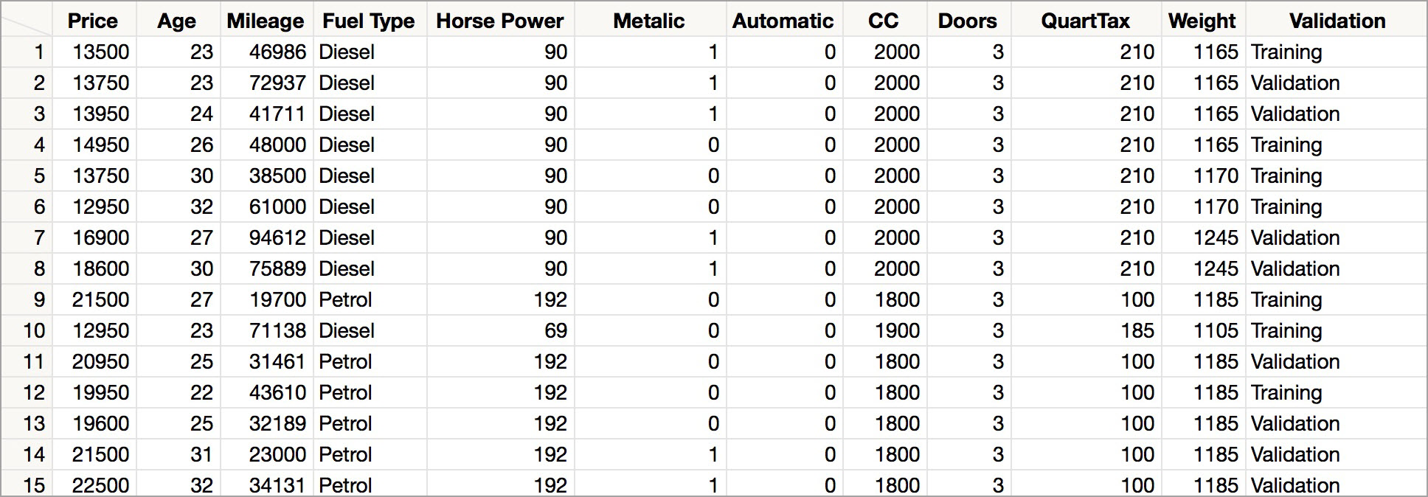
Data Sample
The first 15 cars

Slide 7
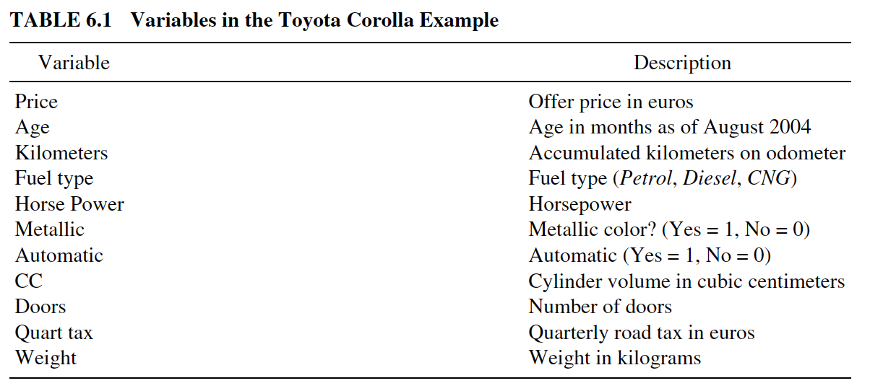
Variables Used

Slide 8
Preprocessing
Data are partitioned: 60% training data / 40% validation data
The partition is indicated in the “Validation” column in the data set.

Slide 9
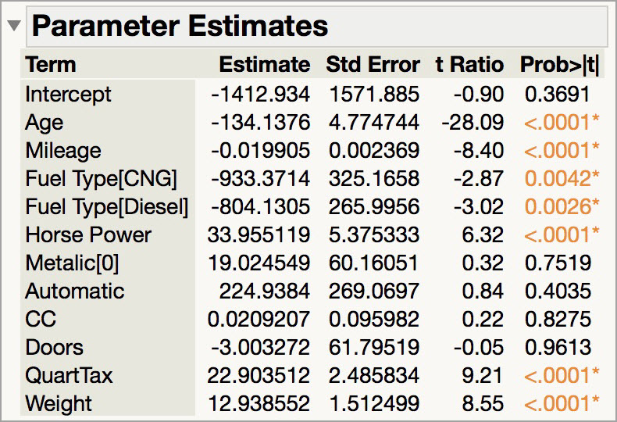
The Fitted Regression Model

Slide 10
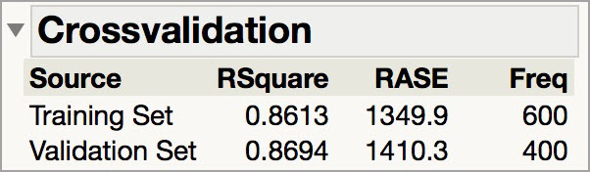
Error reports
RASE for the training and validation data are reported.
To display other measures of prediction error save the prediction formula to the data table and
  use Model Comparison
  Save residuals or use a formula to calculate errors and use Distribution or Tabulate to summarize

Slide 11
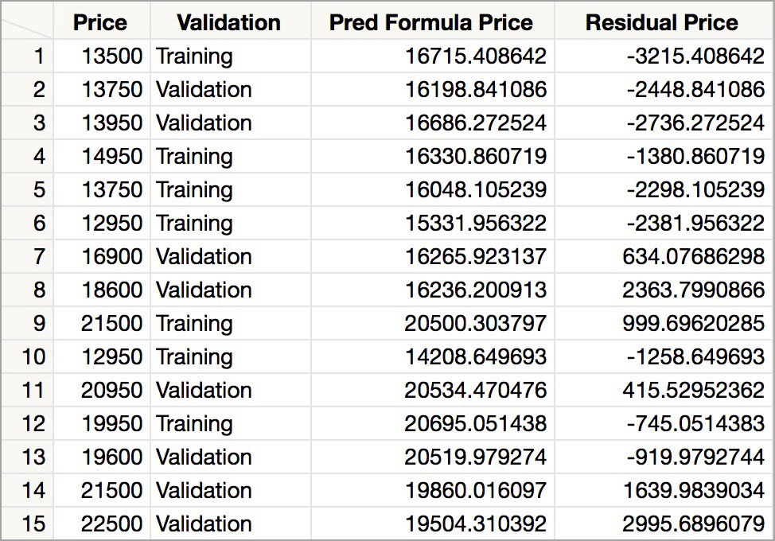
Predicted Values
Predicted price computed using regression coefficients
Residuals (errors) = difference between actual and predicted prices

Slide 12
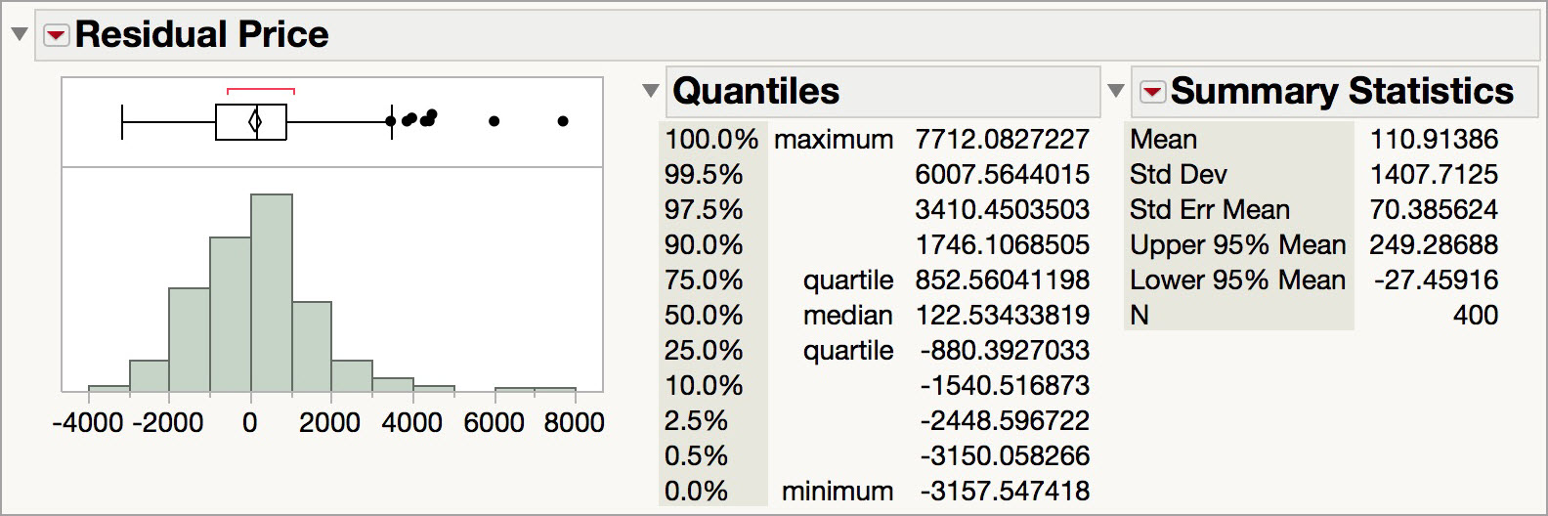
Distribution of Residuals
Symmetric distribution?
Some outliers
What is the average error? Interpret this value.

Slide 13
Selecting Subsets of Predictors
Goal: Find parsimonious model (the simplest model that performs sufficiently well)
  More robust
  Higher predictive accuracy
Exhaustive Search (All Possible Models)
Popular Subset Selection Algorithms
  Forward selection
  Backward elimination
  Mixed Stepwise

Slide 14
P-Value Review
P-Value is the probability that the Null Hypothesis is true.
When considering predictor variables:
Null Hypothesis
  The coefficient for the variable = 0
  The variable is not significant
Alternate Hypothesis
  The coefficient is <> 0
  The variable is significant
Alpha is the threshold for determining significance
  Often 0.05 but depends on business case!

Slide 15
Exhaustive Search
All possible subsets of predictors assessed:
  Each individual predictor
  Pairs of predictors
  Sets of 3 predictors
  Etc
Computationally intensive
Judge by Mallow’s “Cp”, R², RMSE, AICc or BIC
Notes:
Select All Possible Models within the Stepwise platform. To add Cp, right click on the All Possible Models Table and select Columns > Cp

Slide 16
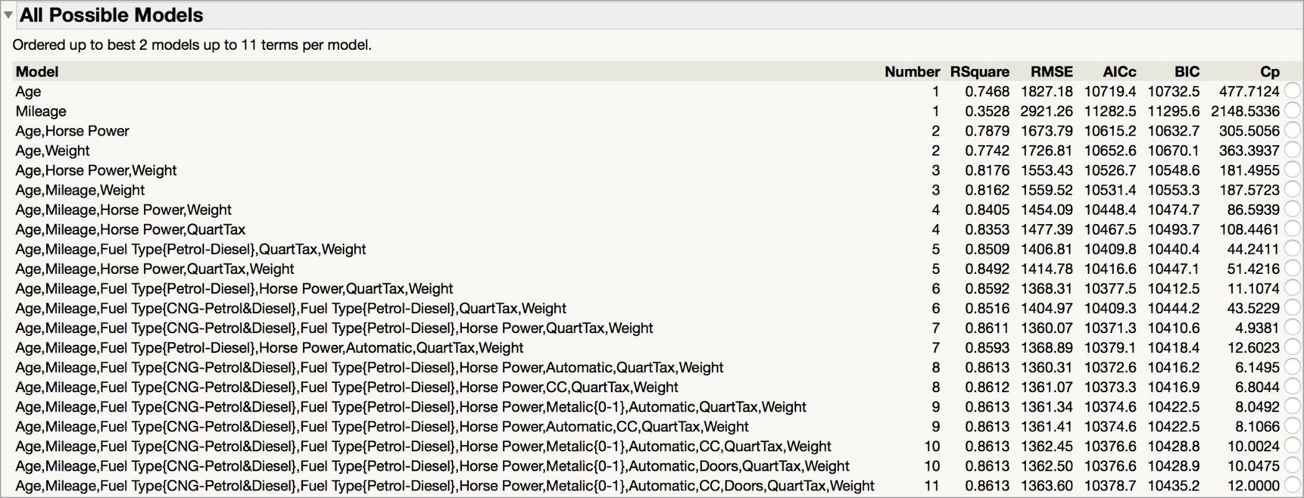
Exhaustive Search
RMSE and AICc point to the first 7 term model. AICc and BIC are lowest for this model, and Cp is also low.
Notes:
Select All Possible Models within the Stepwise platform. To add Cp, right click on the All Possible Models Table and select Columns > Cp

Slide 17
Forward Selection
Start with no predictors
Add them one by one (add the one with largest contribution)
When to stop:
  P-value Threshold: Stop when no other potential predictor has statistically significant contribution
  Max Validation RSquare: Stop when the RSquare on the validation set stops improving when predictors are added (only available when there is a validation column)

Slide 18
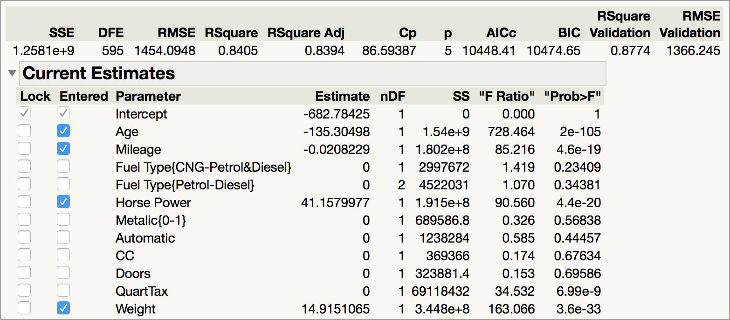
Forward Selection
Best model, using the Max Validation RSquare stopping rule, has 4 terms.

Slide 19
Backward Elimination
Start with all predictors
Successively eliminate least useful predictors one by one
Stopping Rules
  P-value Threshold: Stop when all remaining predictors have statistically significant contribution
  Max Validation RSquare: Stop when the RSquare on the validation set stops improving when predictors are removed (only available when there is a validation column)

Slide 20
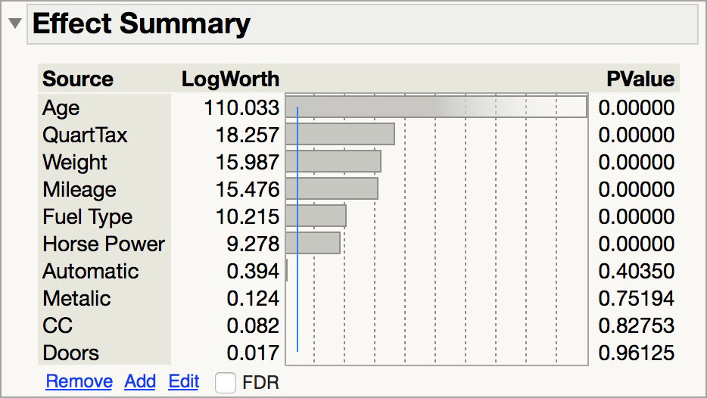
Backward Elimination
Can be done manually in Fit Model using the Effect Summary Table – slowly remove non-significant terms, one at a time.
Notes:
All fit statistics update automatically as terms are removed.

Slide 21
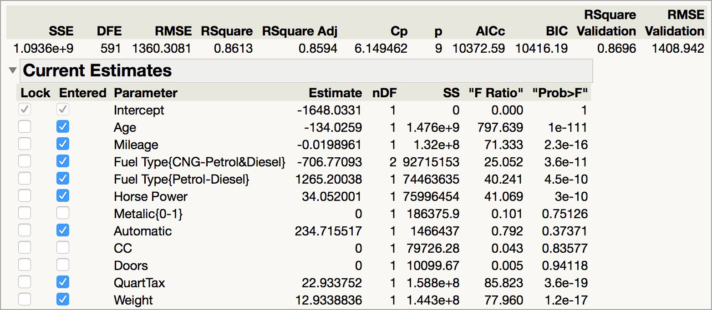
Backward Elimination Model 1
Best model, using the Max Validation Rsquare stopping rule, has 8 terms.

Slide 22
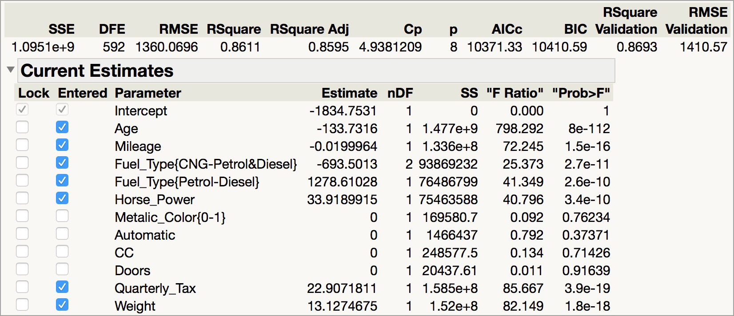
Backward Elimination Model 2
Best model, using the P-Value Threshold (0.15) stopping rule, has 7 terms.

Slide 23
Mixed Stepwise
Like Forward Selection
Except at each step, also consider dropping non-significant predictors
Stopping Rules
    P-value Threshold: Stop removing when all remaining predictors are significant, and stop adding when no other potential predictor is significant

Slide 24
Next step
Subset selection methods give candidate models that might be “good models”
Do not guarantee that “best” model is indeed best
Compare measures of predictive accuracy for the candidate models
  In our example, the 7 term model suggested by All Possible Models and Backward Elimination with the P-Value Threshold has the lowest RMSE value and performs better on other measures (AICc, Rsquare Adj,..).

Slide 25
Summary
Linear regression models are very popular, not only for explanatory modeling, but also for prediction
A good predictive model has high predictive accuracy (to a useful practical level)
Predictive models are built using a training data set, and evaluated on a separate validation data set
Removing redundant predictors is key to achieving predictive accuracy and robustness
Subset selection methods help find “good” candidate models. These should then be run and assessed.

